Slide 1
Facial Emotion Recognition
Prepared by: Chan Yik Siong

Slide 2
Classifier
The goal is to classify facial expression into 7 categories
Angry
Disgusted
Fearful
Happy
Neutral
Sad
Surprised
Used dataset from FER2013 to train models

Slide 3
Two approaches Linear vs Non-linear

Slide 4
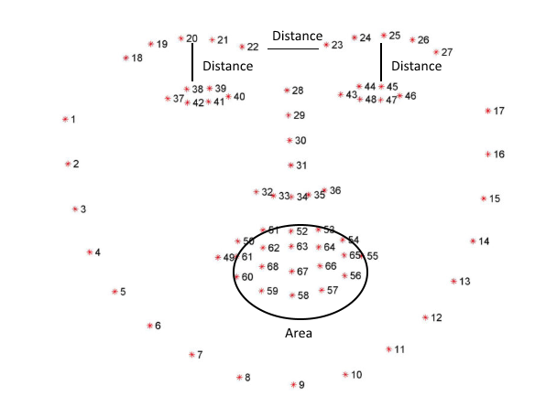
Linear Classifier Approach
Analyzing the distance and area between facial features
Distance between eyes and eyebrows
Distance between eyebrows
Area of mouth and eyes
Eyebrows and mouth are the key facial features as those have major changes between emotions
Set these features for the emotions and classify it with images of similar features

Slide 5
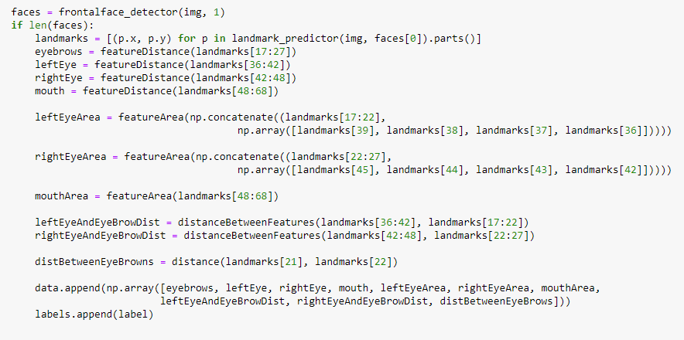
Linear Classifier Approach - Code
Used dlib shape predictor and shape_predictor_68_face_landmarks.dat to extract facial feature
Landmarks indices contain specific facial feature points

Slide 6

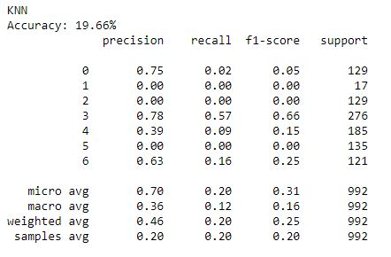
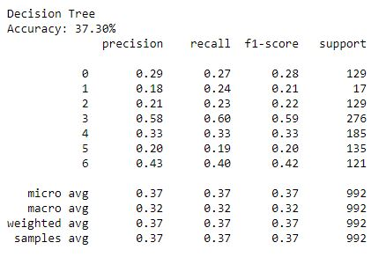
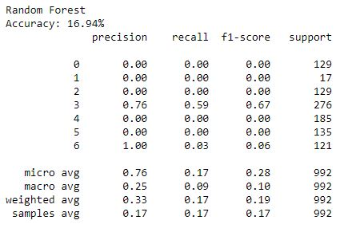
Linear Classifier Approach
Three linear classification algorithms performed
K-Nearest Neighbor
Decision Tree
Random Forest
0 – angry
1 – disgusted
2 – fearful
3 – happy
4 – neutral
5 – sad
6 - surprised

Slide 7
Linear Classifier Approach
The accuracy for decision tree is the highest as it can classify all emotions much better than other two methods
The emotions that have greater precision are happy and surprised as those have bigger changes in the area of mouth to correctly classify
It could also be due the fact that there are more data for happy images
0 – angry
1 – disgusted
2 – fearful
3 – happy
4 – neutral
5 – sad
6 - surprised

Slide 8
Linear Classifier Approach
The f1 score for all these linear classifiers aren’t great and have low chance of predicting emotions
Slightly higher chance than randomly picking (14%)
Tweaking the calculation of facial features may have slight increase in accuracy but I wanted to move on to non-linear classification CNN
0 – angry
1 – disgusted
2 – fearful
3 – happy
4 – neutral
5 – sad
6 - surprised

Slide 9
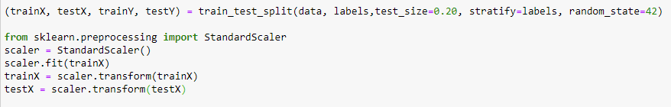
Linear Classifier Approach - Code
Split data between train and test and normalized it
KNN, Decision Tree and Random Forest implementation and training all done using sklearn for easy testing

Slide 10
Convolution Neural Networks

Slide 11
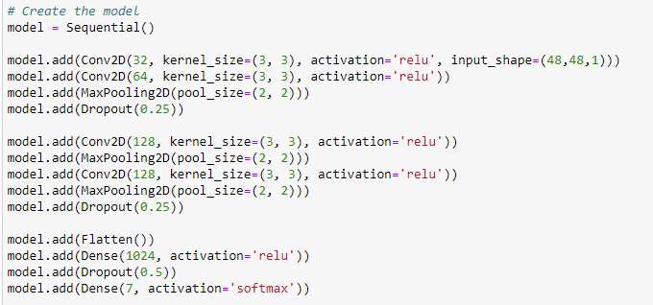
Non-linear Classifier Approach
Extract features from grayscale image to determine facial emotions
Done using ConvNet and classifying it into 7 categories
Libraries used to setup and train model
Keras from tensorflow
Dropout added to help with overfitting issues
Model Setup

Slide 12
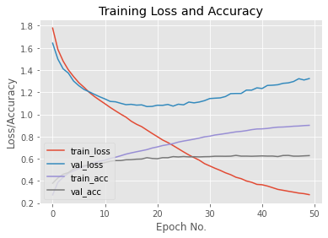
Non-linear Classifier Approach
Trained the model with 50 epochs, learning rate of 0.0001 and batch size of 32
Validation data convergences early on and achieved an accuracy of 60%
Model overfits to the training data significantly
Accuracy could be improved with better layers
Dataset could be more equalized to achieve better results

Slide 13
Detection
Used opencv cascade classifier, haarcascade_frontalface_default.xml, to detect faces
Loaded the weights from model
Run real time detection to predict emotion from current image

Slide 14
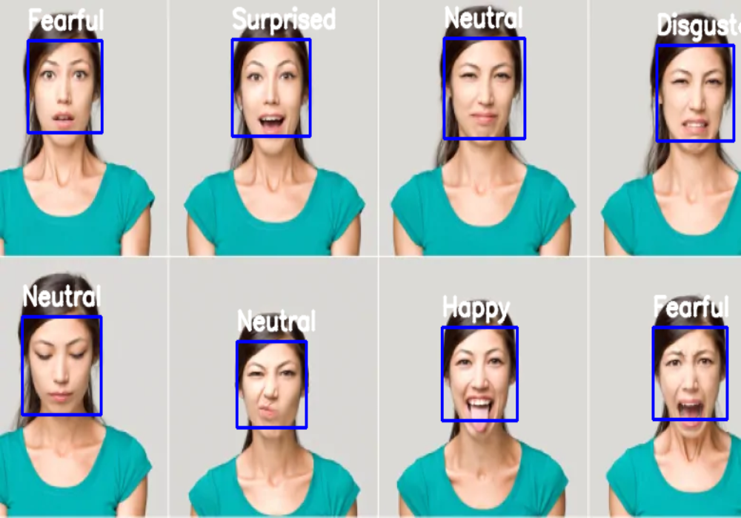
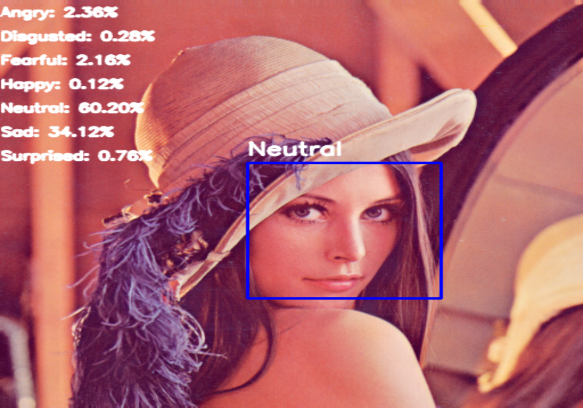
Examples

Slide 15
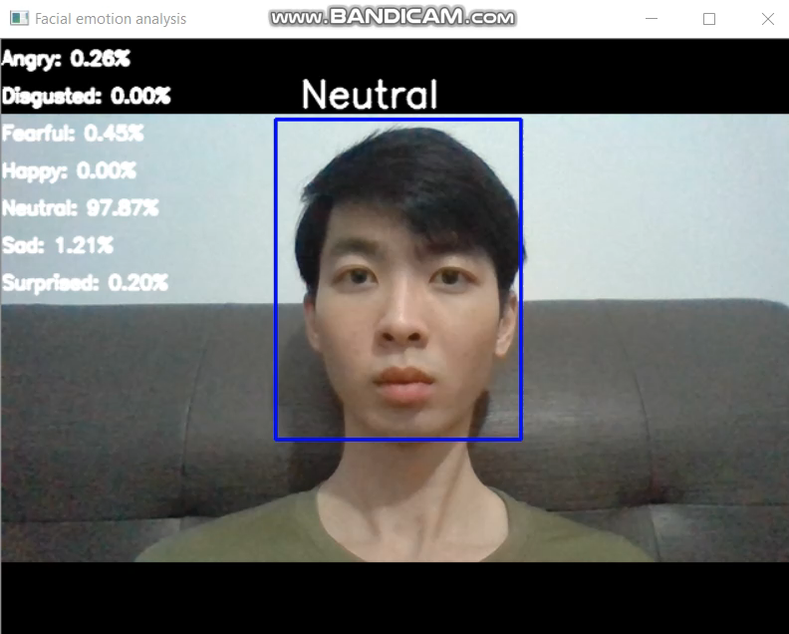
Examples

Slide 16
References
Raut, N. (2018). Facial Emotion Recognition Using Machine Learning [Scholarly project]. In SJSU ScholarWorks. Retrieved August 06, 2020, from https://scholarworks.sjsu.edu/cgi/viewcontent.cgi?article=1643&context=etd_projects
Gupta, A. (2019, December 29). Emotion Detection: A Machine Learning project. Retrieved August 06, 2020, from https://towardsdatascience.com/emotion-detection-a-machine-learning-project-f7431f652b1f
https://github.com/atulapra/Emotion-detection
https://github.com/ohyicong/emotion-detection

